Slide 1
BCOG 100
Neural Circuits
Lecture 3: Logical Computation in Neural Circuits

Slide 2
Reading Check 5-3
Password: logic
Question: what’s the most interesting thing you’ve learned in this class so far?

Slide 3
Logical Computation in Neural Circuits
Recap & Overview
Lecture 1: Circuits as building blocks
Lecture 2: Circuits adapt & learn
Today: Circuits as computation
Notes:
In our first lecture on circuits, we looked at what circuits are —
patterns of neurons connected to produce reflexes, rhythms, and survival behaviors.
Circuits were the building blocks of the brain.
In our second lecture, we saw that circuits aren’t fixed.
They can adapt and change, through processes like adaptation and Hebbian learning.
That’s how experience reshapes wiring.
Today, we’re going to take a different perspective.
Instead of asking how circuits change, we’ll ask: What kinds of computations can circuits perform?
We’ll build on something you already know — linear models —
and show how the same math can describe neurons as abstract processing units.
Then we’ll connect this to logic gates — AND, OR, and NOT.
Finally, we’ll see how combining these simple gates allows circuits to scale up into powerful computational systems.

Slide 4
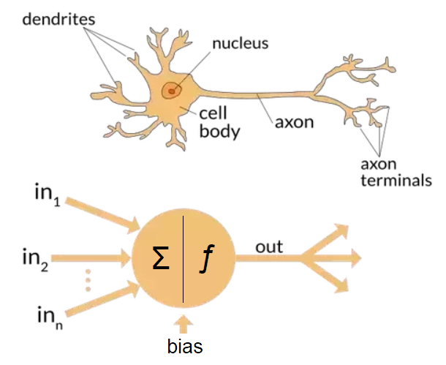
Logical Computation in Neural Circuits
From Biology to Abstraction
Real neurons: graded, noisy, firing rates
Models: simplified on/off threshold units
Abstraction = useful but limited
Notes:
Real neurons are messy.
They fire spikes at different rates, influenced by many factors — neurotransmitters, ion channels, noise.
Information isn’t binary, it’s encoded in firing rates and patterns across populations.
But to study computation, we often make an abstraction:
We sometimes talk about neurons as if they were simple switches.
Each neuron takes inputs, sums them, and if the total is above some threshold, it ‘fires’ — otherwise it stays off.
This abstraction is powerful because it lets us connect neuroscience to computer science.
It allows us to think about neurons as logic units.
But remember: it’s a simplification. It ignores details like firing rates and plasticity.
Later, we’ll come back to those limits.
For now, let’s step into this simplified world —
because it will help us see how neurons can implement things like AND, OR, and NOT.

Slide 5
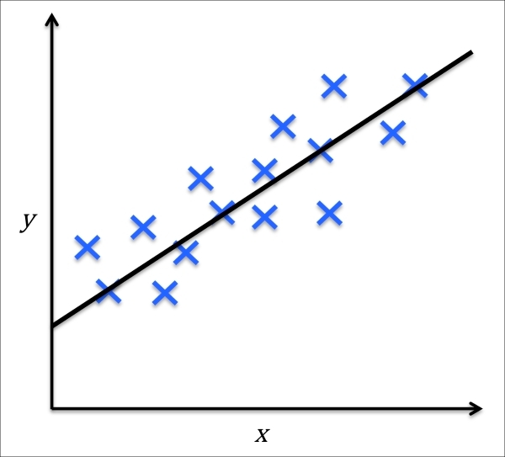
Logical Computation in Neural Circuits
Output Neuron
Firing Rate
Bias firing rate
of y
Formal Model of Neurons
Neuron Model: y = m*x + b
y: output neuron firing rate
x: input neuron firing rate
m: effect x (input neuron) has on y (output neuron)
b: base firing rate of y when x is 0
Neuron Model: y = m*x + b*1
y
1
b
m
x
Input Neuron
Firing Rate
Output Neuron
Firing Rate (y)
Input Neuron Firing Rate (x₁)
Notes:
To make our abstraction more precise,
we can describe a neuron using the same math you’ve already seen with linear models.
Here’s how it works. Let’s start with modeling the simple effect of one neuron on another.
So our outcome variable, y, is the firing rate of the output neuron.
We are predicting y in terms of x, the firing rate of our input neuron.
We start with b, our y-intercept.
This represents the base firing rate of y, when x is not firing.
In depictions of neural networks, the intercept is also sometimes called the “bias” value of y, as in the rate of firing it is biased to have.
The slope of our linear model, m, represents the effect x has on y (so we multiply x by m).
We get our estimated firing rate of y by adding b to x*m.
It is common to see neural network models like this drawn in graphical form.
We have a node for x and y, and label the connection between them as m (the effect of x on y).
If m is positive, then we have an excitatory connection; if its negative we have an inhibitory connection.
A little less intuitive is the graphical depiction of the intercept.
It is also shown as a node, with a value of 1 (instead of a variable like x).
Then it is connected to y with a connection labeled as b, our intercept.
If you think about the equation, this is like writing it as y = b*1 + m*x, which of course is the same as before.
Its just making something implicit more explicit.
We can think of the bias term as representing the sum of all unspecified forces – I
inside and outside the neuron –
that affect its firing rate, other than the neurons we are explicitly modeling.
So that’s the reason to treat this input as a “1”.
Those forces are always present, and making that particular neuron more or less likely to fire in the absence of other input.

Slide 6
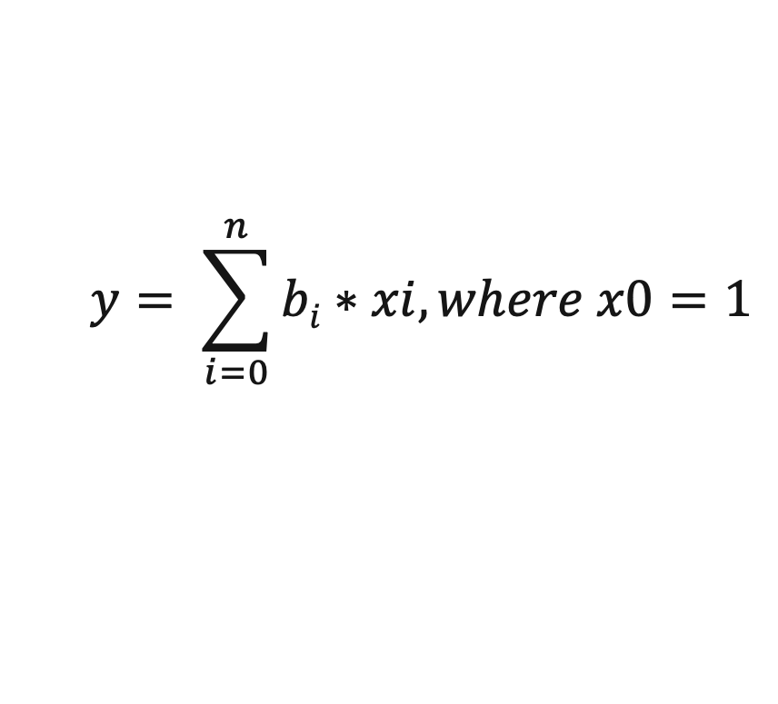
Logical Computation in Neural Circuits
Output Neuron
Firing Rate
Expanded Formal Model of Neurons
Neuron Model: y = m*x + b*1
Neuron Model: y = b*1 + m*x
Neuron Model: y = b*x₀ + m*x₁, where x₀ = 1
Neuron Model: y = b₀*x₀ + b₁*x_{1,} , where x₀ = 1
Neuron Model: y = b₀*x₀ + b₁*x₁ + b₂*x₂ + … + b_{n}*x_{n} , where x₀ = 1
y
b_{n}
b₀
b₁
b₂
x₀=1
x₁
x₂
x_{n}
$$y= \sum_{i=0}^{n}{bi∗xi, where x0=1}$$
…
Bias Firing Rate of y
x₁ Firing Rate
x₂ Firing Rate
x_{n} Firing Rate
Notes:
Now, what happens when we want to model a more complex neural circuit, one with more than one input.
It’s easy, but we need to change our labeling system a little bit. We don’t want to add new letters for each neuron and connection strength.
That get’s confusing, and for big circuits we’ll run out of letters.
But there’s a very elegant solution as we can see in the figure.
What we will do is use one letter for our input neurons – x – with a subscript number denoting which input it is.
Next we need a letter representing the connection strength of each input neuron to each output neuron.
In neural network terminology this is often called the “weight”, the independent parameter describing the effect of each x on y.
Previously we used m and b for these “weights” for the effect of the input neuron and the bias/intercept.
Now we will use a single letter for the effect of each of these inputs on y, again with an subscripted index for keeping track of which input we’re talking about.
Somewhat confusingly, we use b. But now it is not just the intercept or bias, but for the full set of inputs.
We can also see easily how we can transform our equation from y = mx + b to a more generalized formula.
First, swap the order of the intercept the m*x term.
next, relabel the constant 1 as x0, and our input x as x1. These are our numbered inputs, including our bias (intercept) input, which is always 1.
next, relabel our intercept b as b0. its subscript of 0 matches the corresponding x with a subscript of 0. we relabel our m as b1. its subscript of 1 matches the corresponding x with a subscript of 1. These are the “parameters’ of the model, which specify how the circuit will behave, given any set of inputs
Finally, add more x’s and b’s to show that this is a generalizable formula.
We can also rewrite the formula in a more compact way, using sigma notation, showing that our firing rate of y, is just the sum of the products of each input neuron’s firing rate, multiplied by the connection strength of that input neuron to the output neuron.
This is not new or different math, just a different way of writing the same thing.

Slide 7
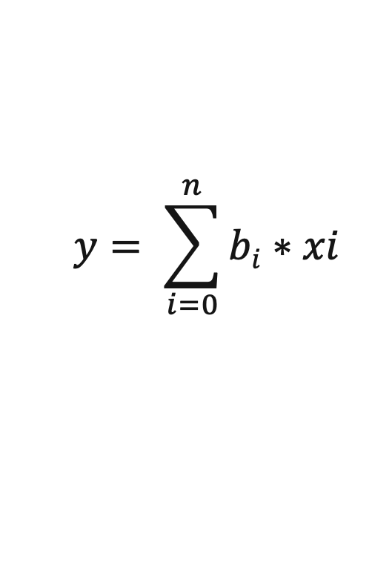
Logical Computation in Neural Circuits
Output Neuron
Firing Rate
Expanded Formal Model of Neurons Example
Neuron | b | x | x*b
x₀ (bias) | 0.2 | 1.0 | 0.2
x₁ | 1.0 | 5.0 | 5.0
x₂ | -2.0 | 2.0 | -4.0
x₃ | 0.001 | 10.0 | 0.01
Net input into y |  |  | 1.21
$$y= \sum_{i=0}^{n}{bi∗xi }$$
y=1.21
y = (0.2*1.0) + (1.0*5.0) + (-2.0*2.0) + (0.001*10.0)
y = 0.2 + 5.0 + -4.0 + 0.01
y = 1.21
b₀=0.001
b₀=1.0
b₀=0.2
x₃=10
x₁=5
x₂=2
b₀=-2.0
…
x₀=1
x₁ Firing Rate
x₂ Firing Rate
x_{n} Firing Rate
Bias Firing rate of y
Notes:
Let’s work through a simple example.
We’re trying to model the firing rate of neuron y.
Neuron y has a bias weight b_0 = 0.2, connected to a constant input x_0 = 1.”
Neuron y has three input neurons, that are firing at rates of 0.3, 0.2, and 1.0, respectively.
Those neurons have weights of 1.0, -0.2 (an inhibitory connection), and 0.01 (a very weak connection that has almost no effect.
We can draw this out in a simple table, with a row for each input (including our bias term).
Column 1 shows the value of x, column 2 shows the value of b, and column 3 shows the product of b times x.
Our last row shows the summed input into y, sometimes called the net input.
Input neuron 1 has a strong effect → pushes output up.
Input neuron 2 inhibits → pushes output down.
Input neuron 3 barely matters → negligible effecy, even though that input neuron is firing rapidly, because its weight is very small.
Bias ensures the neuron has some baseline activity even with no inputs.

Slide 8
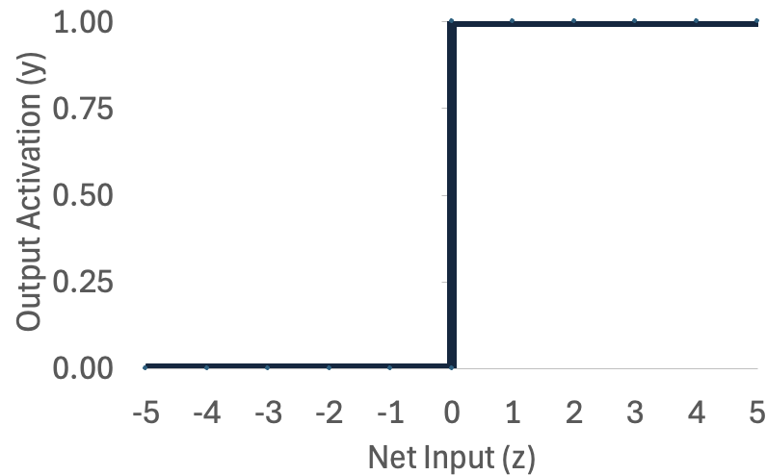
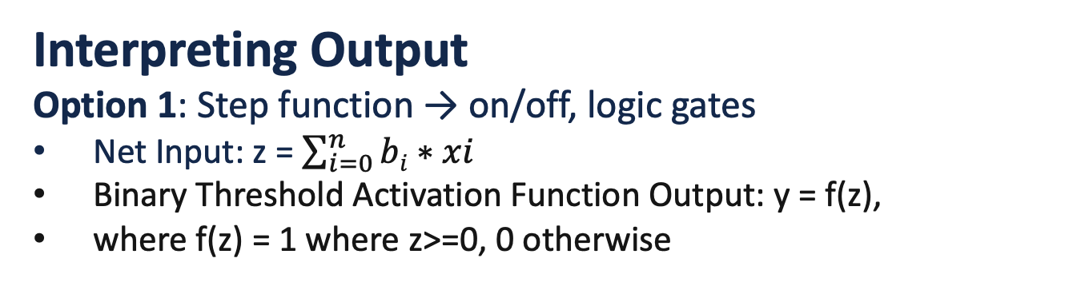
Logical Computation in Neural Circuits
Interpreting Output
Option 1: Step function → on/off, logic gates
Net Input: z = $\sum_{i=0}^{n}{bi∗xi }$
Binary Threshold Activation Function Output: y = f(z),
where f(z) = 1 where z>=0, 0 otherwise
x₀=1
y
x₁
z
x₂
Notes:
Now, you may be noticing something problematic about this model.
What happens if the negative input outweighs the positive input, resulting in a negative value of y?
What does it mean to have a ”negative firing rate”?
This is actually why, so far, we have been referring to the value of y as the “net input” into y.
Usually in neural network models we do not model this value as the firing rate itself.
Instead, it is the input into a more complex function, called the activation function, that relates the
net input of y to its firing rate.
There are many activation functions we can use.
One option is a step function: if the input is above the threshold, the neuron ‘fires’ (1); if not, it stays off (0).
This is the classic logic gate view — which treats each neuron as either firing or not firing (with nothing in between).
So the step function is useful when we want to link neurons to digital logic.
The sigmoid is more realistic when we want to capture how firing rates work biologically. Both are abstractions —
which one we use depends on the question we’re asking.”

Slide 9
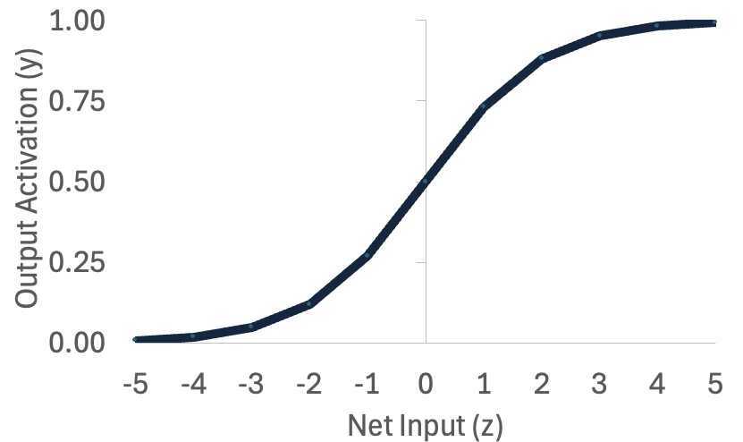
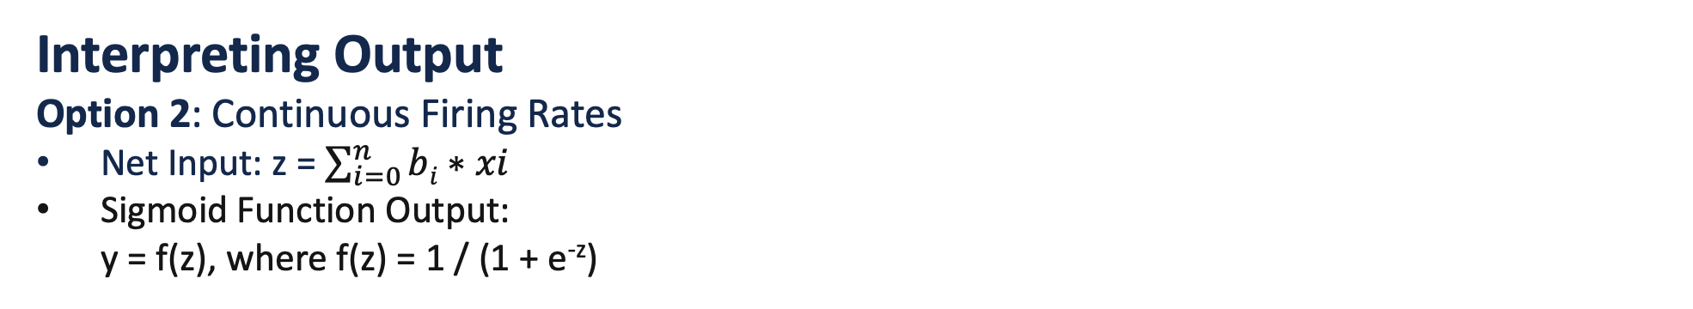
Logical Computation in Neural Circuits
Interpreting Output
Option 2: Continuous Firing Rates
Net Input: z = $\sum_{i=0}^{n}{bi∗xi }$
Sigmoid Function Output: y = f(z), where f(z) = 1 / (1 + e^{-z})
x₀=1
y
x₁
z
x₂
Notes:
But real neurons don’t just flip between off and on. They vary their firing rates. T
hat’s where other kinds of activation functions, like the sigmoid function, come in.
The sigmoid function It maps a neuron’s net input to its outputs smoothly to a value between 0 (representing not firing at all) and 1 (firing at its maximum possible rate).
The sigmoid is like a dimmer switch: it smoothly turns the light up from 0 to 1, instead of snapping on and off
The math of the sigmoid function is actually quite simple,
You don’t have to know what e is (the natural logarithm constant of about 2.718.
you just remember the basics of how exponents work.
Consider the case where your net input is 0.
This is a case where the positive excitatory and negative inhibitory inputs cancel out.
In this situation, z = 0. and remember that any number raised to the zeroth power is 1.
So that makes the denominator of the sigmoid function 2, and 1/2 = 0.5
So when the excitatory and inhibitory inputs cancel out to a net input of 0, the neurons firing rate will be right in the middle at 0.5.
Compare that to a situation where the net input z is very excitatory. A really really big number.
In this case, we are raising e to a really really big negative number.
Raising a number to a negative number makes it a fraction.
The more negative number that is, the smaller the fraction is.
As z approaches infinity, the fractional result of e^-z will approach zero, and so the z term effectively goes away.
That will make the denominator 1 + 0, or 1, and make the overall output of the sigmoid function 1.
So as the net input becomes positive the output becomes 1
and it does so in an exponentially fast way that rises quickly from 0.5 when z=0 to about 0.95 when z=3, and about 0.999 when z=8.
When the net input z is inhibitory, the opposite happens.
When z is negative, and it is multipled by the negative in the sigmoid equiation, this makes the exponent positive.
As z bcomes more negative e^{-z} becomes a large and larger positive number, making the denominator big.
This means we are going to add the value of z to the 1 in the denominator.
That means as z gets more negative, the denominator gets bigger and bigger.
And so the result of the sigmoid function, 1 divided by the denominator, gets smaller and smaller.
As z approaches negative infinity, the sigmoid of z approaches 0.
Sigmoids give us a very nice way to model neural networks as collections of neurons with different firing rates,
whose values vary between 0 (not firing at all) and 1 (firing at their maximum possible rate.

Slide 10
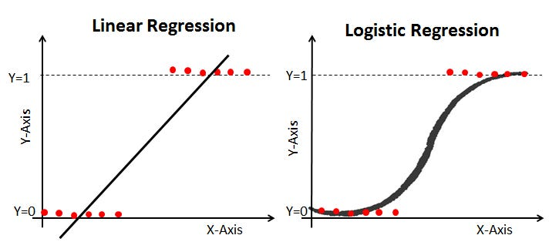
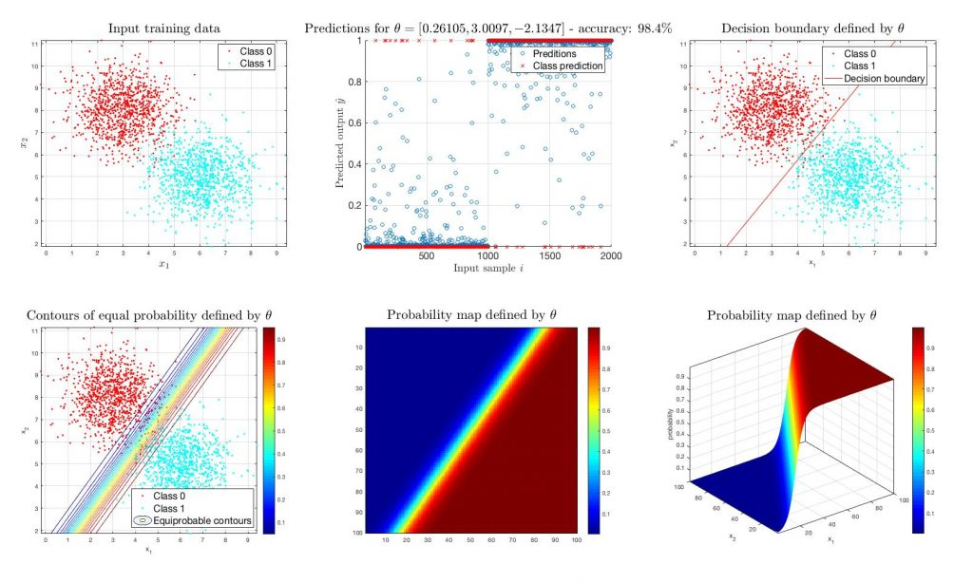
Logical Computation in Neural Circuits
Logistic Regression and Classifier Models
Notes:
Now that we’ve introduced the sigmoid as a way of mapping net input into firing rates between 0 and 1,
I want to point out something important: this is exactly what a common statistical model — logistic regression — does.
You may remember from earlier in the semester how linear regression models a line that best fits continuous data.
But when the outcome is binary — yes or no, fire or not fire — a straight line doesn’t work very well.
That’s where logistic regression comes in.
What you see here on the left is data with a binary outcome that can’t really be modeled by a straight line.
A linear regression line either under- or overshoots.
But the logistic regression curve fits perfectly because it uses the sigmoid function as its prediction rule.
And if we go to higher dimensions — like when we have two predictors — the same logic applies.
Instead of a line on a graph, we now get a smooth surface, a curved boundary that separates the space into ‘likely 1’ and ‘likely 0.’
This is the mathematical foundation of treating a neuron with a sigmoid activation function as a classifier.

Slide 11
Logical Computation in Neural Circuits
Logistic Regression and Classifier Models
Learning a decision boundary between input classes
On one side of the boundary, output neuron should fire at its maximum rate
On the other side of the boundary, output neuron should not fire at all
Notes:
Here we can take this one step further. Logistic regression doesn’t just give us a smooth prediction curve — it also defines a decision boundary.
Think of this scatterplot. We’ve got two clusters of input data points. Logistic regression fits a line that separates them. On one side of the line, the neuron’s output shoots up toward 1 — meaning it ‘fires’ at its maximum rate. On the other side of the line, the output drops down toward 0 — meaning it stays silent.
This is a powerful way to think about neurons and networks: each one is learning where to put a decision boundary in its input space. By stacking many such units together, you can build systems that carve up input space into very complex categories. But at the single-neuron level, it all comes down to this: separating one set of inputs from another with a decision boundary.

Slide 12
Logical Computation in Neural Circuits
Logic as Target Functions
Boolean functions = desired input–output patterns
AND, OR, NOT → truth tables
Our goal: approximate these with sigmoid neurons
Is there a set of weights (b0, b1, and b2) that can output something like the value of y for every combination of x1 and x2, such that this circuit calculates OR over its inputs?
x₀=1
Truth Table for OR
x1 | x2 | y
1 | 1 | 1
1 | 0 | 1
0 | 1 | 1
0 | 0 | 0
b₀
x₁
b₁
z
y
x₂
b₂
Notes:
Ok. So we have set up the basics of how we can formally model neural circuits.
Now we can look at some of the neat stuff we can do with this formalism.
We could look at how we can use these techniques in conjunction with some of the basic neural circuits we have already talked about, like feedforward, feedback, and other kinds of circuits.
But we’re going to jump right into how we can use these circuits to model the building blocks of thinking: logical computation.
Let’s pause and ground ourselves in some basics.
A function is just a rule that maps inputs to an output.
You give it an input, it gives you an output. You’ve seen this with linear models.
Plug in values for x, get out a prediction y.
A Boolean function is the same idea, but the inputs and outputs are restricted to 0 or 1.
Take the OR function. It has two inputs.
The rule is: the output is 1 if either of the inputs are 1. Otherwise, the output is 0.
We can see this in the truth table, where we’ve switched from the T’s and F’s we used for
true and false to 1’s and 0’s
This is equivalent to saying the neuron will be firing at its maximum rate to represent that the information
it is coding for is True, and not firing at all if the information it is coding for is False.
That’s it — a Boolean function is just a mapping from all possible input combinations to their outputs.
Our goal now is to see if a neural circuit using sigmoid neurons can approximate this mapping for logical functions.
In other words, the truth table is what we want the neural circuit to represent.
Is there a set of weights (b0, b1, and b2) that can output the correct value for a logical function, for all possible values of x1 and x2, such that it calculates OR over its inputs?

Slide 13
Logical Computation in Neural Circuits
Logical OR Neural Circuit
x₀=1
z
y
Neuron | b | x | x*b
x₀ | -4 | 1 | -4
x₁ | 10 | 1 | 10
x₂ | 10 | 1 | 10
z |  |  | 16
y=sigmoid(z) |  |  | 0.999
Neuron | b | x | x*b
x₀ | -4 | 1 | -4
x₁ | 10 | 0 | 0
x₂ | 10 | 0 | 0
z |  |  | -4
y=sigmoid(z) |  |  | 0.018
b₀
Neuron | b | x | x*b
x₀ | -4 | 1 | -4
x₁ | 10 | 1 | 10
x₂ | 10 | 0 | 0
z |  |  | 6
y=sigmoid(z) |  |  | 0.998
b₁
x₁
b0 | b1 | b2
-4 | 10 | 10
b₂
x₂
x0 | x1 | x2 | y
1 | 1 | 1 | 1
1 | 1 | 0 | 1
1 | 0 | 1 | 1
1 | 0 | 0 | 0
x0 | x1 | x2 | y | o
1 | 1 | 1 | 1 | .018
1 | 1 | 0 | 1 | .998
1 | 0 | 1 | 1 | .998
1 | 0 | 0 | 0 | .999
Notes:
We can show that an OR circuit is very easy to create.
First, let’s show our truth table. But we’re going to add a column for our bias unit.
Remember this y value is not the OR of x0 and x1 and x2, just the OR of x1 and x2.
But it’s still a function, in the sense that there is one correct output value of y for every combination of inputs.
We can see that y is 1 when either x1 or x2 is 1, and 0 otherwise.
Now, let’s show a table of hypothetical weights: [-4, 10, 10].
Our bias (b0) is -4, which means our output neuron will be inhibited from firing in the absence of other input.
Our weights from both x1 and x2 are 10, meaning the neuron will be excited by activation from either of input neurons.
And note that this activation strength of 10 is higher than the inhibitory strength of 4.
This means that either input will overwhelm the neuron’s inhibitory bias and make it fire. We can show that with specific example tables.
The first shows the calculation of the firing rate of the output neuron when one but not the other input is firing at its maximum rate.
The net input is 6 (-4+10+0).
When put through the sigmoid activation function the result is an output activation of 0.998.
The second shows the calculation of the firing rate of the output neuron when both inputs are firing at their maximum rate.
The net input is 16 (-4+10+10).
When put through the sigmoid activation function the result is an output activation of 0.999.
Note that because the sigmoid function maxes out at 1, and that point was already nearly reached when the net input was 6.
Going from a net input of 6 to 16 makes very little difference in the output firing rate because it has already maxed out.
We can compare to the calculation of the firing rate of the output neuron when neither input is firing.
The net input is -4(-4+0+0).
When put through the sigmoid activation function the result is an output activation of 0.018.
So for an OR circuit, we want to inhibit the output neuron, but only a little bit, such that that inhibition can be overcome by a single input.

Slide 14
Logical Computation in Neural Circuits
Logical AND Neural Circuit
x₀=1
b₀
z
y
Neuron | b | x | x*b
x₀ | -15 | 1 | -15
x₁ | 10 | 1 | 10
x₂ | 10 | 1 | 10
z |  |  | 5
y=sigmoid(z) |  |  | 0.993
Neuron | b | x | x*b
x₀ | -15 | 1 | -15
x₁ | 10 | 1 | 10
x₂ | 10 | 0 | 0
z |  |  | -5
y=sigmoid(z) |  |  | .007
Neuron | b | x | x*b
x₀ | -15 | 1 | -15
x₁ | 10 | 0 | 0
x₂ | 10 | 0 | 0
z |  |  | -15
y=sigmoid(z) |  |  | <0.001
b₁
x₁
b0 | b1 | b2
-15 | 10 | 10
b₂
x₂
x0 | x1 | x2 | y
1 | 1 | 1 | 1
1 | 1 | 0 | 0
1 | 0 | 1 | 0
1 | 0 | 0 | 0
x0 | x1 | x2 | y | o
1 | 1 | 1 | 1 | .993
1 | 1 | 0 | 0 | .007
1 | 0 | 1 | 0 | .007
1 | 0 | 0 | 0 | .001
Notes:
We can contrast this with a circuit that computes AND
We have our truth table with the bias column added, showing that the y should be 1 when both x1 and x2 are 1, and zero otherwise.
This time our weights will be: [-15, 10, 10].
Our bias (b0) is -15, which means our output neuron will again be inhibited from firing in the absence of other input.
Our weights from both x1 and x2 are 10, meaning the output neuron will be excited enough by the activation from either of input neurons to overcome its bias rate of inhibition (10 < 15).
But if we add both inputs together, that will be enough to get the neuron to fire (10+10 = 20 > 15). We can again show that with specific example tables.
The first shows the calculation of the firing rate of the output neuron when one but not the other input is firing at its maximum rate.
The net input is -5 (-15+10+0).
When put through the sigmoid activation function the result is an output activation of 0.07.
The second shows the calculation of the firing rate of the output neuron when both inputs are firing at their maximum rate.
The net input is 5 (-15+10+10).
When put through the sigmoid activation function the result is an output activation of 0.993.
We can compare to the calculation of the firing rate of the output neuron when neither input is firing.
The net input is -15 (-15+0+0).
When put through the sigmoid activation function the result is an output activation of < 0.001.
So for an AND circuit, we want to inhibit the output neuron, and quite a bit, so that it requires both of our input neurons to be firing rapidly to overcome that inhibitory bias.

Slide 15
Logical Computation in Neural Circuits
Function | b0 | b1 | b2
AND | -15 | 10 | 10
OR | -4 | 10 | 10
Takeaway: AND vs. OR
For both functions, both inputs need to have the same positive weights
But the two functions need to have different bias values
Bias = neuron’s threshold or baseline activity
0,1
1,1
1,1
0,1
AND
OR
x1
x1
0,0
x2
0,0
1,0
x2
1,0
Notes:
Here’s the big idea to take away.
In both AND and OR, we used the same setup: two positive weights. The difference wasn’t in the wiring — it was in the bias.
Bias is like the neuron’s built-in threshold, or its baseline firing rate.
If the bias is more negative, it takes stronger input to activate the neuron.
That gave us AND. If the bias is less negative, weaker input is enough, which gave us OR.
We can also think about this in terms of the decision boundaries we introduced earlier.
Here, we plot our four inputs as points on a graph, and color code the responses green if the output neuron should be 1, and red if zero.
As you can see, the colors are different for AND and OR reflecting the differences in those logical structures.
To get a neural network to work correctly for these two logical functions, all we need to do is draw the decision boundary in a slightly different place.
So the distinction between AND and OR isn’t about different circuit structures.
It’s about how ‘picky’ the neuron is — how much input is required to push it over the threshold.
That’s a powerful idea: small parameter changes in a simple model can lead to very different computations.

Slide 16
Logical Computation in Neural Circuits
Logical NOT Neural Circuit
x₀=1
b₀
z
y
Unit | b | x | x*b
x₀ | 5 | 1 | 5
x₁ | -10 | 1 | -10
z |  |  | -5
y |  |  | 0.001
Unit | b | x | x*b
x₀ | 5 | 1 | 5
x₁ | -10 | 0 | 0
z |  |  | 5
y |  |  | 0.999
b₁
x₁
b0 | b1
2 | -5
x0 | x1 | y | o
1 | 1 | 0 | .001
1 | 0 | 1 | .999
Notes:
Now let’s try the simplest Boolean function: NOT.
Here the neuron has just one input. The rule is: if the input is 0, the output should be 1. If the input is 1, the output should be 0.
To do this, we need an inhibitory weight. Instead of a positive weight, we set a negative one. For example:
Weight = -10, Bias = +5.
Check the cases:
When x1 is 1, then the net input is 1*-10 + 1*5 = -5. Which has a sigmoid value of 0.001. So we have flipped the 1 to a 0.
When x1 is 0, then the net input is 0*-10 + 1*5 = 5. Which has a sigmoid value of 0.999. So we have flipped the 0 to a 1.
So a neuron with a strong negative weight acts like a NOT gate.
This is an important reminder: in biology, some synapses are excitatory (positive weights), others inhibitory (negative weights).
Both are needed to build flexible logic.

Slide 17
Logical Computation in Neural Circuits
x₀=1
b₀
z
y
Logical XOR
XOR = output 1 if inputs are different
Not linearly separable (can’t do with 1 neuron)
Solution: combine AND, OR, NOT
b₁
x₁
x1 | x2 | y
1 | 1 | 0
1 | 0 | 1
0 | 1 | 1
0 | 0 | 0
b₂
x₂
1,1
1,1
0,1
0,1
XOR
OR
x1
x1
0,0
0,0
x2
x2
1,0
Notes:
Now that we’ve seen single neurons approximate AND and OR, let’s look at a harder case: XOR.
XOR outputs 1 when the inputs are different — (1,0) or (0,1) — but 0 when they’re the same.
This is actually a very hard problem, and impossible to create in a neural circuit of the type we have been using so far.
Conceptually it is somewhat easy to understand. The (0,0) situation should lead to a 0, so we want a negative bias just like AND and OR.
The bias needs to be overcome by either or our inputs, so the negative bias should be lower than the positive weight of both of our x inputs.
But when both inputs are on, we want the output neuron to be inhibited again.
There’s no way to get our output neuron to correctly respond to the either/or case ((0,1) and (1,0)) in a way that is opposite of our AND (1,1,) case.
We can also understand it in terms of decision boundaries.
There is no way to draw a single line to divide the green dots and red dots on separate sides.
Because of this, XOR is described as a problem that is not linearly separable, in contrast to AND and OR, which are linearly separable.

Slide 18
Logical Computation in Neural Circuits
XOR (x1,x2) = OR(x1,x2) AND NOT(AND(x1,x2))
x1 | x2 | y
1 | 1 | 0
1 | 0 | 1
0 | 1 | 1
0 | 0 | 0
x₁
h₁
0,1
1,1
y
XOR
x₂
h₂
x1
0,0
x1 | x2 | h1=OR(x1,x2) | AND(x1,x2) | h2=NOT(AND(x1,x2)) | y=AND(H1,H2)
1 | 1 | 0 | 0 | 1 | 0
1 | 0 | 1 | 0 | 1 | 1
0 | 1 | 1 | 0 | 1 | 1
0 | 0 | 1 | 1 | 0 | 0
Notes:
The solution is to combine gates.
XOR can be built from a special conjunction of AND, OR, and NOTs combined in just the right way.
Think about what XOR means. We can actually break it down into saying
XOR of x1 and x2 is equal to saying OR of x1 and x2, but also NOT x1 AND x2.
More formally, XOR (x1,x2) = OR(x1,x2) AND NOT(AND(x1,x2)).
We can show this is true in a truth table.
First, we create an intermediate argument called h1, which is the OR truth table for x1 and x2.
We also create a truth table for AND of x1 and x2, and then the negation of that result. We call that result h2.
We can then do AND of h1 and h2, and the result of that is just what we are looking for for XOR.
Now we can also see what that would look like as a neural circuit.
The interneurons that mediate between x and y here are sometimes called “hidden units”.
Each of those hidden units is themselves a classifier unit learning a function.
One is learning OR. The other is learning NOT AND.
We can draw each of those lines separately in the classifier plot.
Then, our final y neuron needs to learn to respond to those lines, rather than to the initial points.
And it can say, y should fire when an input is to the bottom left of the top-right line
AND when that input is also to the top right of the bottom left line.
XOR is a nonlinearly separable problem that can be broken down into a set of smaller problems that are linearly separable.

Slide 19
Logical Computation in Neural Circuits
Scaling Up: Adder Network
Logic gates can be chained to do arithmetic
Example: binary “full-adder” circuit
Circuits can compute sums, carry bits
Notes:
We’ve seen how combining logic gates gives us more power, like with XOR. But the story doesn’t stop there.
From computer science we know that logic isn’t just for reasoning about true and false — it’s the foundation of computation.
If you can build AND, OR, and NOT, you can combine them into circuits that carry out math, memory, and much more.
For example, you can wire gates together to create a simple binary adder.
A half-adder takes two binary inputs and produces a sum and a carry.
XOR handles the sum, and AND handles the carry.
We won’t dive into the wiring details here.
The key idea is this: logic scales up.
Once you have these basic building blocks, you can implement arithmetic and, eventually, a full computer.

Slide 20
Logical Computation in Neural Circuits
Scaling Up: Visual Classifier
Networks of neurons can classify patterns
Example: distinguishing “cats” vs. “dogs”
Simple network can learn decision boundary
Notes:
Logic isn’t just about numbers and arithmetic.
It can also help us think about how the brain — and artificial neural networks — classify things in the world.
The idea is this: deciding whether something is an instance of a category can,
in theory, be broken down into a very complicated set of logical choices.
Imagine a deep network that processes images:
The first layer might have neurons that act like AND gates for sequences of aligned pixels, detecting edges at particular orientations.
The next layer combines those edges into simple shapes.
Another layer might combine shapes into parts, like eyes or wheels.
Finally, higher layers combine parts into whole objects, like a face or a car.
Each layer adds complexity by combining simpler logical patterns into more structured ones.
That’s how a network of simple, logic-like units can, step by step, build up to recognizing objects.

Slide 21
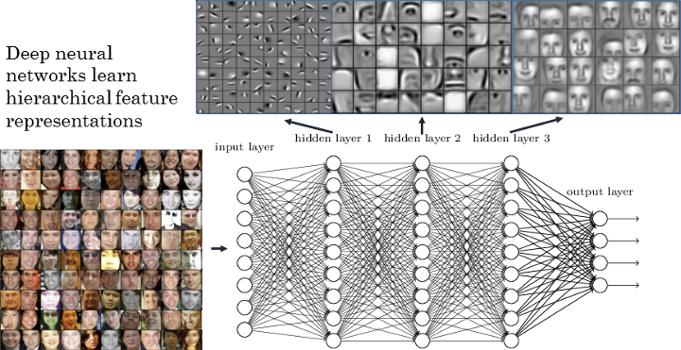
Logical Computation in Neural Circuits
Notes:
Analyses have been performed on both artificial neural networks that are good at recognizing objects, and human brains, finding strikingly similar patterns.
Early units detect edges, later units combine those into shapes and later units full images.

Slide 22
Logical Computation in Neural Circuits
Recap & Overview
Lecture 1: Circuits as building blocks
Lecture 2: Circuits adapt & learn
Today: Circuits as computation
Notes:
Today we’ve pulled together a lot.
We started by modeling neurons as linear functions with a sigmoid output.
That gave us a way to think about neurons as implementing logic-like operations.
We saw that simple gates like AND, OR, and NOT can be approximated by single neurons.
Then we scaled up: XOR showed us why single neurons aren’t enough, but also how combining them gives us more power.
From there we saw how logic circuits can grow into arithmetic and, conceptually, into the layered pattern recognition that underlies vision.
The big takeaway is this: neurons, like transistors, are simple units.
But when you wire them together, you can get computation.
And when you add plasticity, you get adaptability.
But there’s one big piece missing: motivation. So far, our learning rule has been blind —
it only reinforces co-activation.
But animals don’t just wire up patterns because they occur together.
They learn what matters based on rewards and punishments.
That’s where reinforcement learning comes in. Next week, we’ll explore how brains use reward signals — especially dopamine —
to shape behavior, and how reinforcement learning connects circuits to action, decision-making, and motivation.

